Slide 1
INTRODUCTION TO C#
Liane Stevenson | @webdevelopwolf | www.webdevelopwolf.com

Slide 2
INTRODUCTION
What to learn

Slide 3
What are we doing today?
Object Orientation
Environment Setup
The .NET Framework
Hello World!
Debugging

Slide 4

Need help?
Github:
http://www.github.com/webdevelopwolf/training
Twitter:
http://www.twitter.com/webdevelopwolf
Facebook:
http://www.facebook.com/webdevwolf

Slide 5
OBJECT ORIENTATION
Objects?! Naaaaah, lets build a car instead…

Slide 6
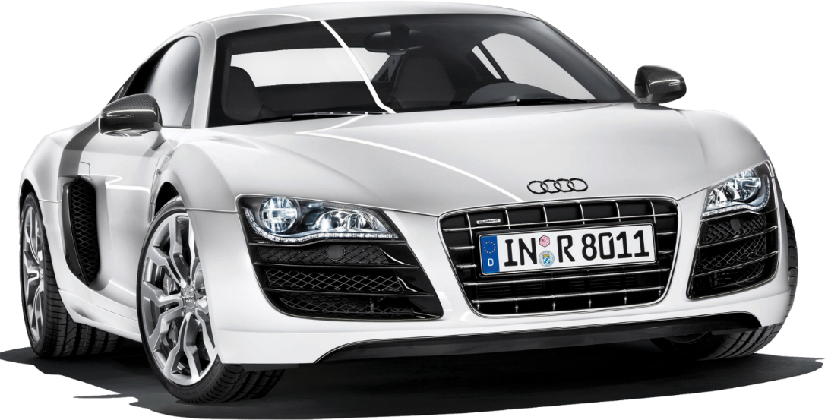
Talking about cars…
What does a car need?
Frame - Looks
Engine - Performance
All cars have unique attributes
Lights
Windows
Trim
Paint etc.
These are the car’s properties

Slide 7
Talking about cars…
Cars have more/less functions
Automatic windows
Automatic wipers
Toggle daytime running lights
These may/may not be dependant upon it’s attributes
Yet they will all need to move forward / backward
These are the car’s methods

Slide 8

Talking about cars…
So…lets build a car!
Car (Audi R8)
Light: Angel Eye, Daylight
Windows: 0%
Mirrors: Chrome
Go forward
Go backward
Toggle daytime lights

Slide 9
So Li, what the hell has this got to do with C#?!
C# is an object orientated language
Information and commands are contained in objects
Commands are called methods
The information they manipulate are called properties
The car’s features are it’s properties and it’s actions are methods
For example…

Slide 10
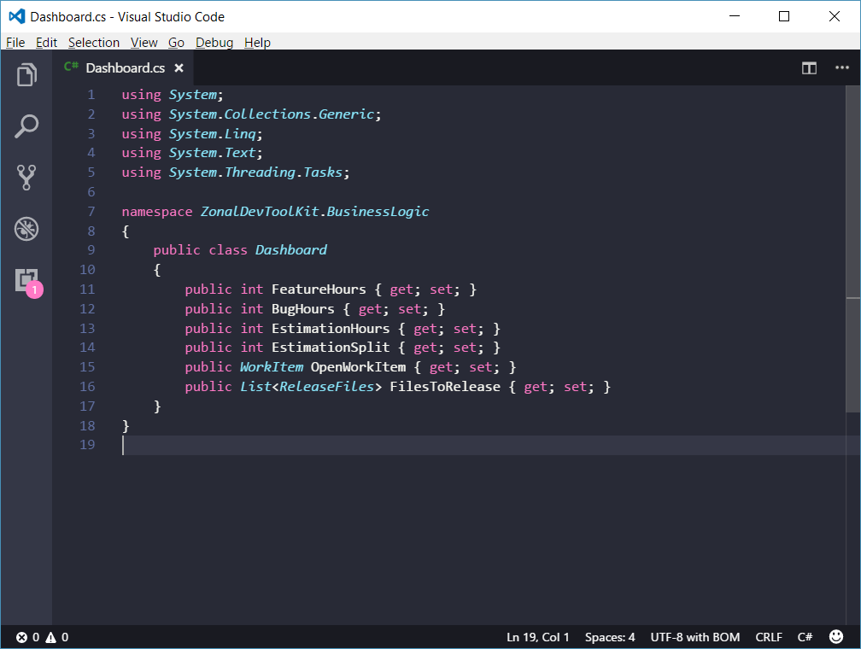
C# Example Object

Slide 11
ENVIRONMENT SETUP
Now for the fun part…

Slide 12
THE .NET FRAMEWORK
Less fun, but compulsory…

Slide 13
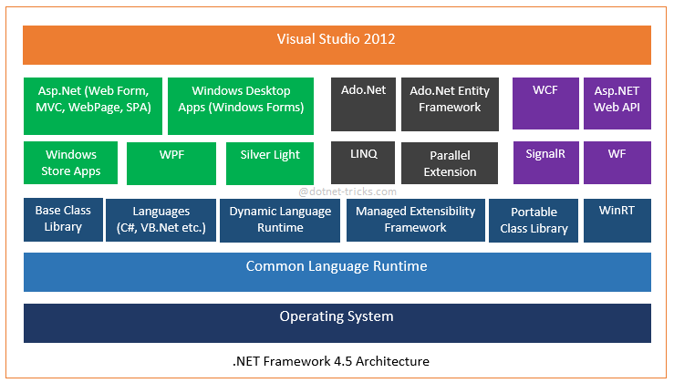
What is it? Any do I need it?

Slide 14
HELLO WORLD
Here’s where it gets interesting…

Slide 15
DEBUGGING
If hell were made of semi colons and curly braces – it would look like this – continue if you dare…

Slide 16
What’s a bug? And how do I ‘de’ it?
An error in code
Syntax Error – Misspellings, missing / illegal characters
Logic Error – Code acts other than expected
You've programmed a toy car to drive around a map, but when it reaches a house the car continues to drive through it! Which type of bug does your program have?
Logic bug – the car continues to run, but does not behave as expected

Slide 17
Common Syntax Errors
Mis-spelling
Missing semi-colons
Incorrect scope
Don’t worry if you don’t know what this is – we’ll get to it later
Incorrect commands
Incomplete commands

Slide 18
Common Logic Errors
Loops that never exit
Code that cannot be reached
And everything else that causes software to break!

